Slide 1
Analysis of Crime Neighboring Sporting Events
Springboard Data Science Capstone Project
Francisco Salas
https://github.com/franksalas/SpringboardCapstone

Slide 2
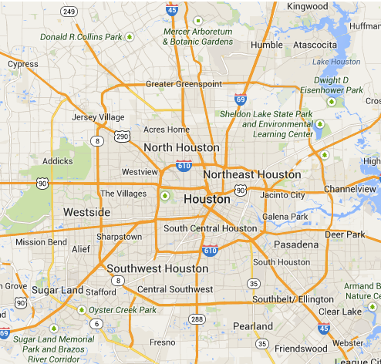
Problem
Houston Texas has around 2.3 million residents
~600 square miles
Four professional sport teams
Two NCAA Division I-A schools.
What is the likelihood of a crime around a sports stadium given the event?

Slide 3

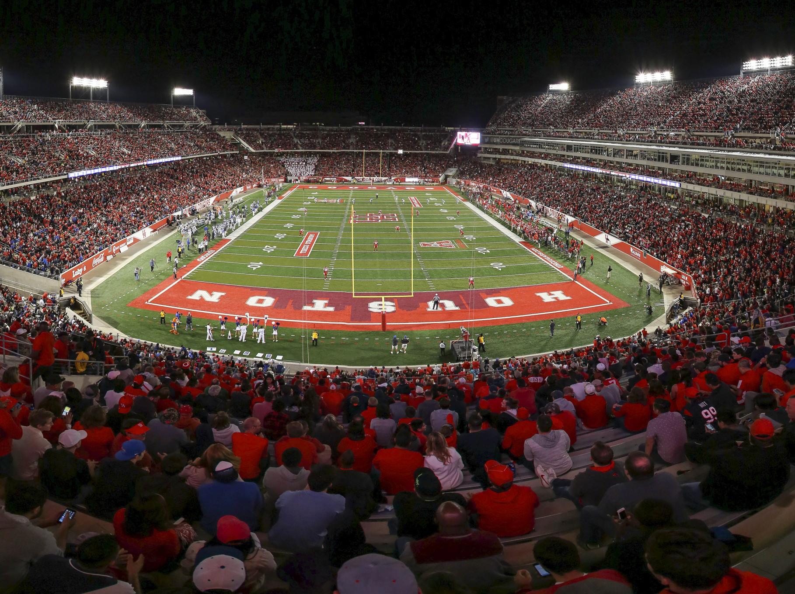
Who Might Care?
Houston Police Department
City planners
Sporting event attendees.

Slide 4
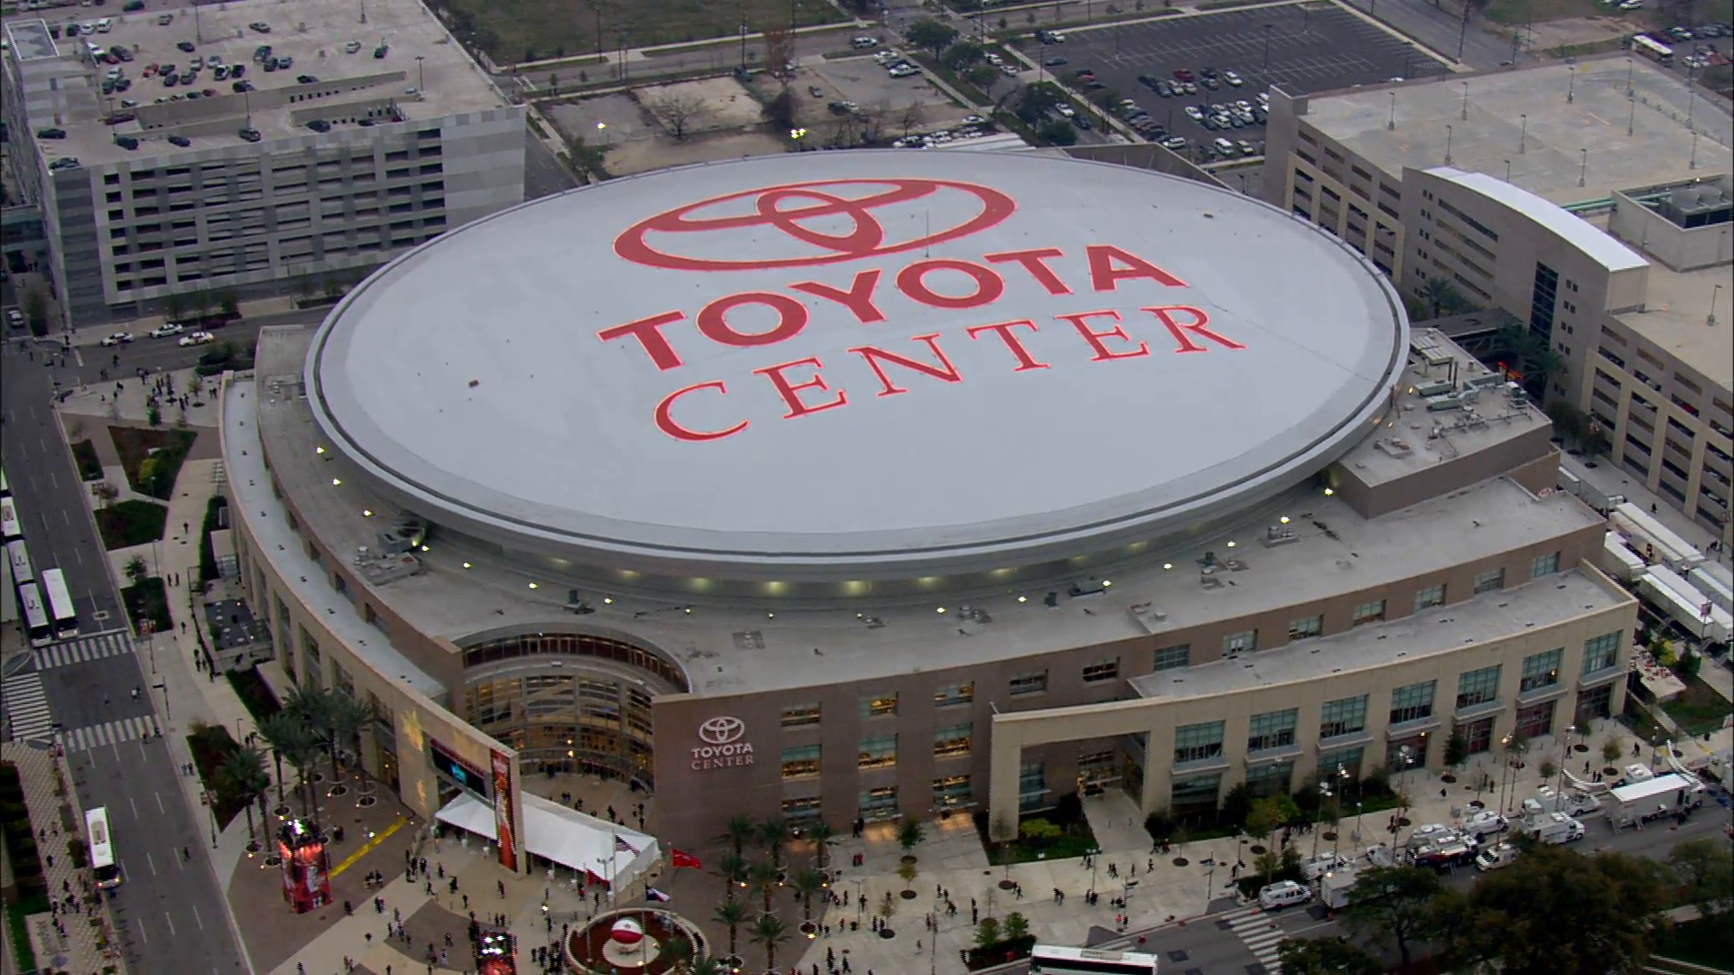
Venue : Toyota Center
NBA
Houston Rockets
Capacity
18,500
Coordinates
29° 45′ 3″ N, 95° 21′ 44″ W

Slide 5
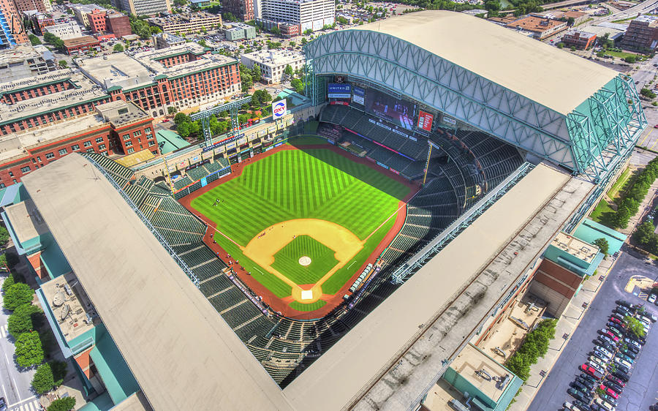
Venue : Minute Maid Park
MLB
Houston Astros
Capacity
41,000
Coordinates
29°45′25″N 95°21′20″W

Slide 6
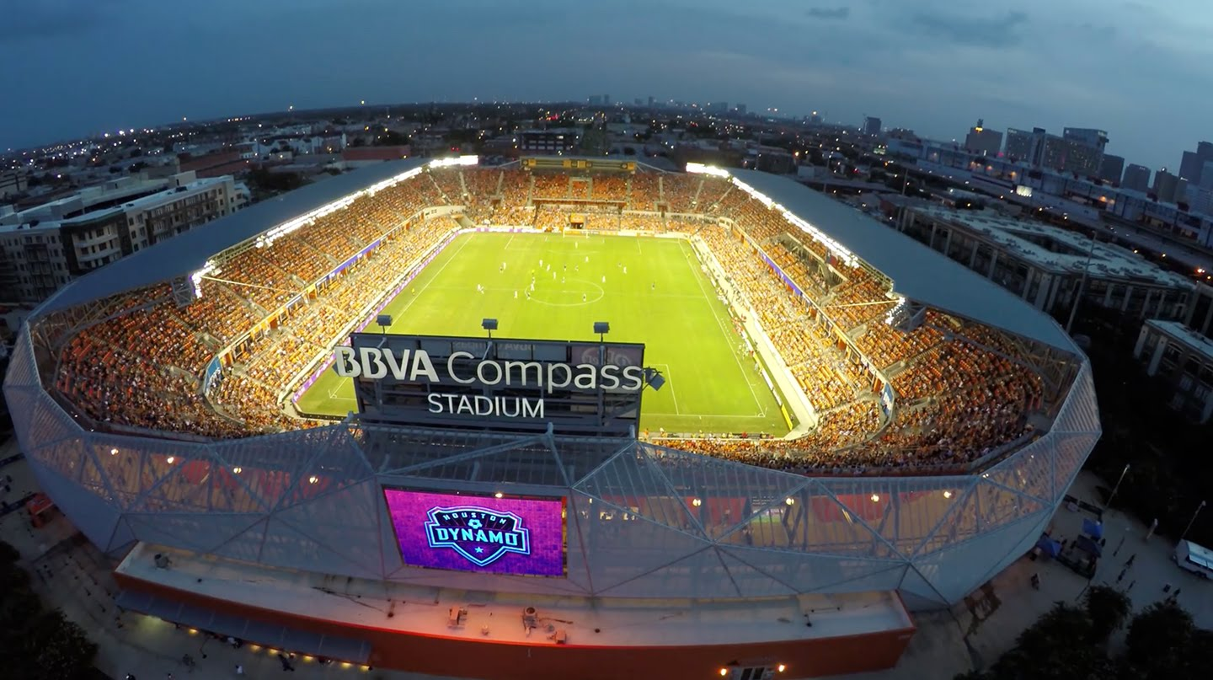
Venue : BBVA Compass Stadium
MLS
Houston Dynamo
Capacity
22,000
Coordinates
29° 45′ 7.92″ N, 95° 21′ 8.64″ W

Slide 7
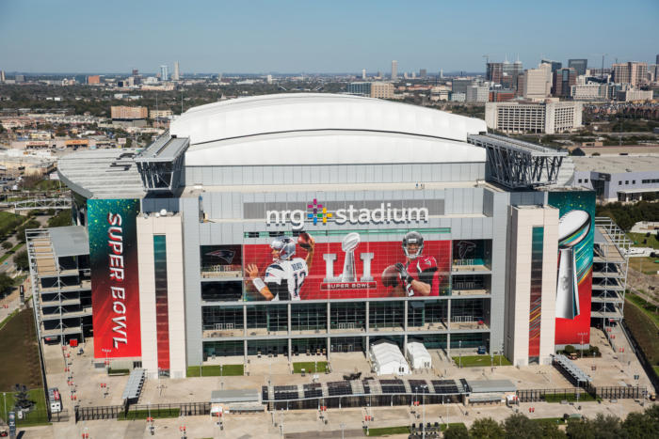
Venue: NRG Stadium
NFL
Houston Texans
Capacity
72,000
Coordinates
29° 41′ 5″ N, 95° 24′ 39″ W

Slide 8
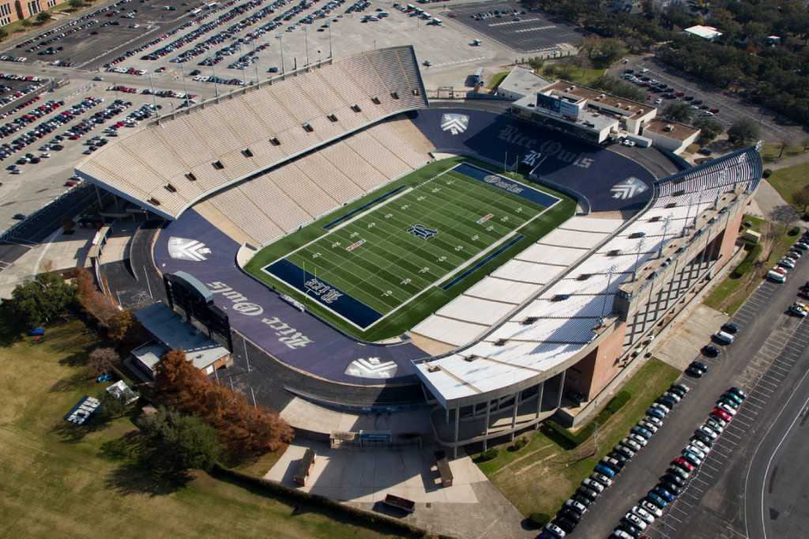
Venue : Rice Stadium
College Football
Rice University
Capacity
47,000
Coordinates
29° 42′ 59″ N, 95° 24′ 33″ W

Slide 9
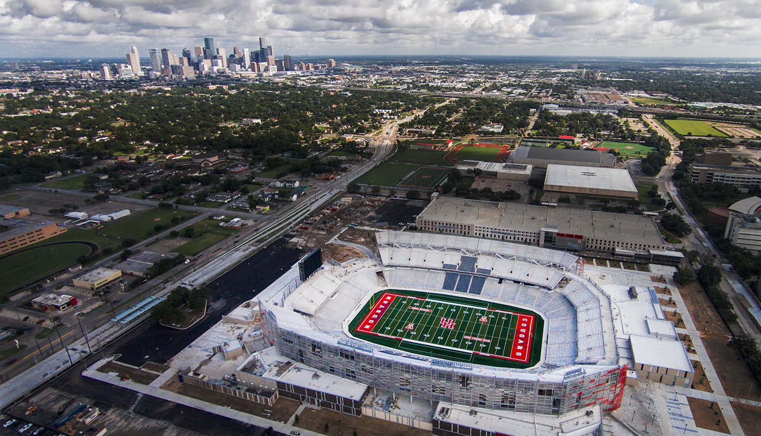
Venue : TDECU Stadium
College Football
University of Houston
Capacity
40,000
Coordinates
29° 43′ 19″ N, 95° 20′ 57″ W

Slide 10
Datasets
https://github.com/franksalas/SpringboardCapstone/tree/master/data_wrangling_v2

Slide 11
Uniform Crime Report Program
Published by the FBI
Program that compiles official data on crime in the US
Data is collected by local law enforcement agencies
Two types
Type I
Type II

Slide 12
Offense Types
Type I Crimes : On Report | Type II Crimes : Not on Report
Aggravated assault | Simple assault
Rape | Curfew offenses
Murder | Loitering
Robbery | Embezzlement
Burglary | Forgery
Theft | Counterfeiting
Auto Theft | .. any offense not on Type I

Slide 13
Crime Datasets
Provided by Houston Police Department
Monthly files from 2010 -2017
96 excel files
Variable | Description
Date | Date of offense, include month/date/year
Hour | Approximate time when an event occurs, value form 0-24
Offense Type | Type I offense
Beat | The geographic area of the city broken down for patrol and statistical purpose
Premise | Identify the type of location where crime occurs (apartment complex, parking lot, etc.)
Block Range | The value range of street
Street Name | Name of the street where the offense occurred
Type | Street type, rd, Blvd
Suffix | N, S, E, W
Offenses | Times offense happen within the time frame

Slide 14
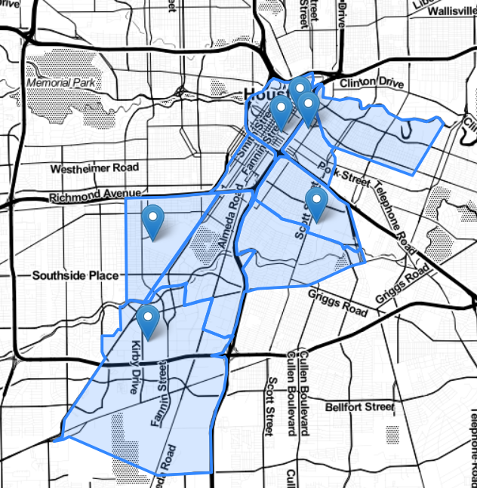
Crime Datasets
Police Beats used
15E40 | 10H40
10H50 | 10H60
10H80 | 10H30
10H10 | 1A10
10H70
Crime data was only selected from Police Beats around stadiums

Slide 15
Sports Datasets : Schedule & Scores
Site | Sports Data Extracted
sports-reference.com | NBA MLB CF: UH CF: RU
github.com/jokecamp/FootballData | MLS
sportsradar.us | NFL

Slide 16
Data Exploration
https://github.com/franksalas/SpringboardCapstone/tree/master/data_exploration

Slide 17
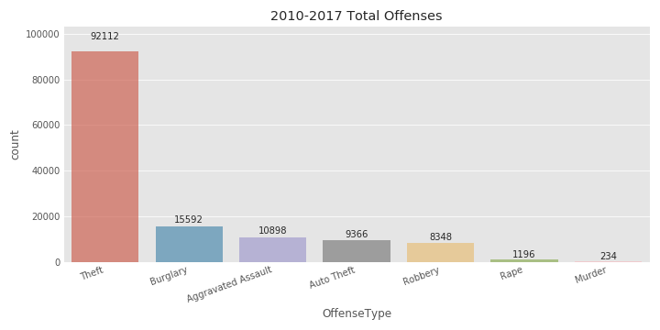
Total offenses 2010-2017
*Selected Police Beats

Slide 18
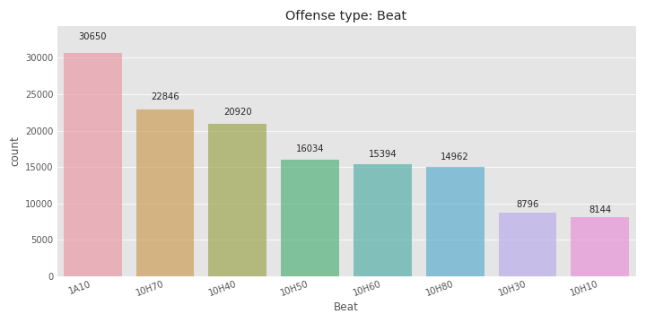
Sum of Crimes by Police Beat
*Selected Police Beats

Slide 19
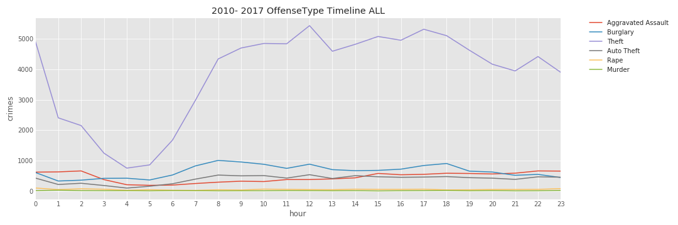
Timeline Offense Type
*Selected Police Beats

Slide 20
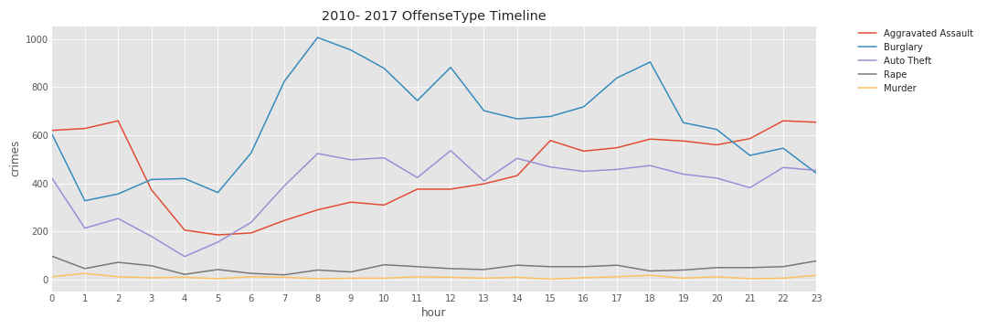
Timeline Offense Type (theft removed)
*Selected Police Beats

Slide 21
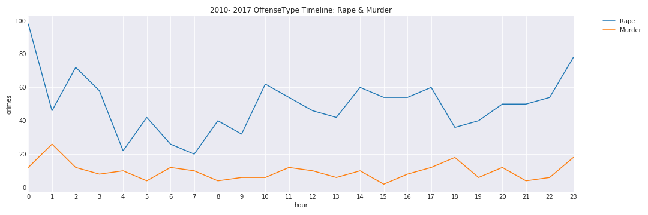
Timeline : Rape & Murder
*Selected Police Beats

Slide 22
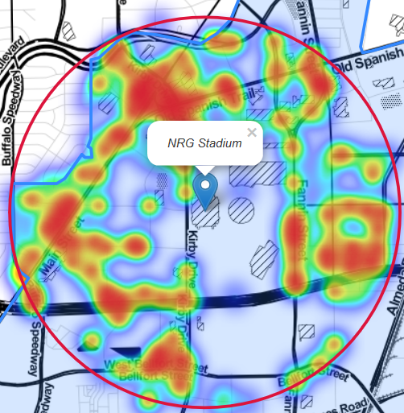
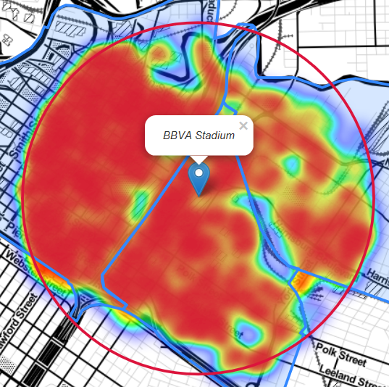
Crime Heatmap
NRG Stadium
BBVA Stadium
1 mile radius around stadium

Slide 23
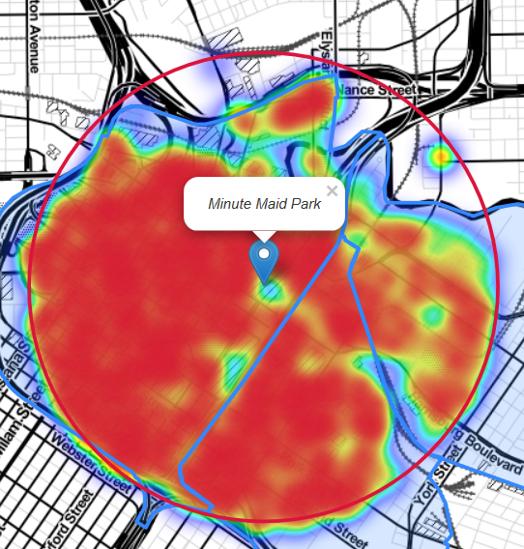
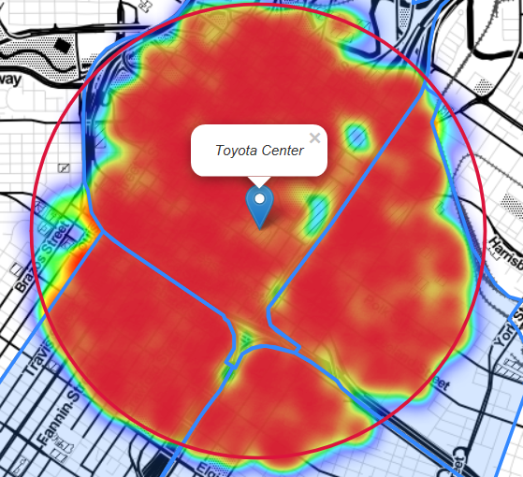
Crime Heatmap
Minute Maid Park
Toyota Center
1 mile radius around stadium

Slide 24
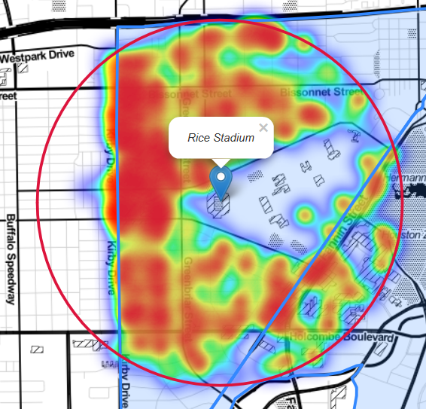
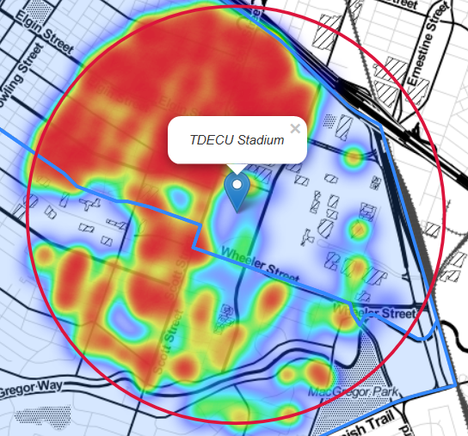
Crime Heatmap
Rice Stadium
TDECU Stadium
1 mile radius around stadium

Slide 25
Modeling
https://github.com/franksalas/SpringboardCapstone/tree/master/final

Slide 26
Supervised Learning
Linear Regression:
Ordinary least squares Linear Regression.
Ridge:
Linear least squares with l2 regularization.
Lasso:
Linear Model trained with L1 prior as regularized.

Slide 27
Dataset
Target
crime_total
Predictors
~ crime_total
crime_total | year | dist_stadium_median | hour_mode | Weekday_Monday | …

Slide 28
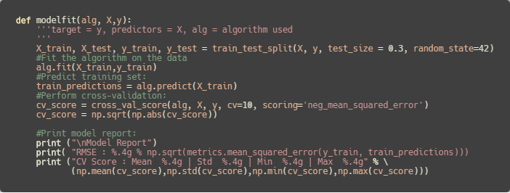
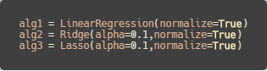
Supervised Learning : Plugin Function
Function
Algorithms used

Slide 29
Results
https://github.com/franksalas/SpringboardCapstone/tree/master/final

Slide 30
TDECU Stadium
Results
Linear | Model Report RMSE : 1.077 CV Score : Mean 5.234e+13 | Std 1.317e+14 | Min 3.493 | Max 4.45e+14
Ridge | Model Report RMSE : 1.704 CV Score : Mean 4.767 | Std 3.785 | Min 1.255 | Max 13.5
Lasso | Model Report RMSE : 2.782 CV Score : Mean 4.701 | Std 4.044 | Min 1.393 | Max 12.09

Slide 31
Rice Stadium
Results
Linear | Model Report RMSE : 0.0716 CV Score : Mean 2.004e+14 | Std 4.137e+14 | Min 1.32 | Max 1.32e+15
Ridge | Model Report RMSE : 0.6496 CV Score : Mean 1.595 | Std 0.7066 | Min 0.2395 | Max 2.417
Lasso | Model Report RMSE : 1.357 CV Score : Mean 1.283 | Std 0.4084 | Min 0.7061 | Max 2.274

Slide 32
NRG Stadium
Results
Linear | Model Report RMSE : 4.733 CV Score : Mean 3.006e+13 | Std 9.019e+13 | Min 5.866 | Max 3.006e+14
Ridge | Model Report RMSE : 5.195 CV Score : Mean 8.908 | Std 3.495 | Min 4.1 | Max 15.28
Lasso | Model Report RMSE : 6.08 CV Score : Mean 7.667 | Std 3.242 | Min 3.67 | Max 12.71

Slide 33
Toyota Center
Results
Linear | Model Report RMSE : 3.04 CV Score : Mean 2.718e+06 | Std 8.084e+06 | Min 2.718 | Max 2.697e+07
Ridge | Model Report RMSE : 3.079 CV Score : Mean 3.47 | Std 0.7354 | Min 2.501 | Max 5.116
Lasso | Model Report RMSE : 3.907 CV Score : Mean 3.689 | Std 0.8254 | Min 2.687 | Max 5.62

Slide 34
Minute Maid Park
Results
Linear | Model Report RMSE : 2.811 CV Score : Mean 6.38e+13 | Std 1.081e+14 | Min 2.994 | Max 3.154e+14
Ridge | Model Report RMSE : 2.818 CV Score : Mean 3.085 | Std 0.3041 | Min 2.538 | Max 3.513
Lasso | Model Report RMSE : 3.231 CV Score : Mean 3.249 | Std 0.3112 | Min 2.772 | Max 3.79

Slide 35
BBVA Compass Stadium
Results
Linear | Model Report RMSE : 2.478 CV Score : Mean 2.521e+13 | Std 4.274e+13 | Min 2.7 | Max 1.355e+14
Ridge | Model Report RMSE : 2.554 CV Score : Mean 3.653 | Std 0.9231 | Min 2.467 | Max 5.433
Lasso | Model Report RMSE : 3.515 CV Score : Mean 3.602 | Std 0.8621 | Min 2.05 | Max 5.239

Slide 36
Thank you

